Slide 1
Training Linear Model
Maryam Zubair
Student Id : 19709

Slide 2
Linear Regression Model:
Introduction
Design
Implementation
Testing
Enhancement
Conclusion
Bibliography/References

Slide 3
Introduction:
In this problem, I am using google colab to implement Linear regression model which is used for predictive modeling and can help to identify trends and patterns in dataset. I am taking “abalone” dataset in this problem and will use Normal equation to find the best-fit parameters (i.e., the intercept and coefficients) to get the most “accurate predictions”.

Slide 4
Design:
In the given problem, the goal is to build a model that can predict the height of abalone based on the length. We are not comparing the height based on all physical measurements.
Need to find best-fit parameters (i.e., the intercept and coefficients) to minimize the mean squared error between the predicted target values and the true target values which gives us the most “accurate predictions”.
The best fit parameters can be found using different methods such as Gradient Descent, Mini-Batch Gradient Descent, Singular-Value Decomposition and many more.
But I choose Normal Equation for my problem, as we are just predicting height on the basis of one feature.
I believe normal equation is well-suited for this task as it is simple and efficient method for finding the optimal values of parameters, particularly when the number of features is small.

Slide 5
Implementation :
Used numpy array for array computing and for performing mathematical operations
Created a Feature Matrix ‘X’ and Target Matrix ‘y’
Manipulated the Feature matrix by adding a Bias term to it. Bias term allows the regression line to have an intercept (i.e., y-intercept) makes the model flexible to handle cases where the target variable does not go through the origin.
Calculated Theta using Normal Equation: θ = ((X^T * X)^(-1)) * (X^T * y) which gives best fit parameters to find accurate predicted values
Created another 2-D array with two instances and added a bias term to it.
Used theta (best fit parameters) along with new instances in order to find array of predicted target values.

Slide 6
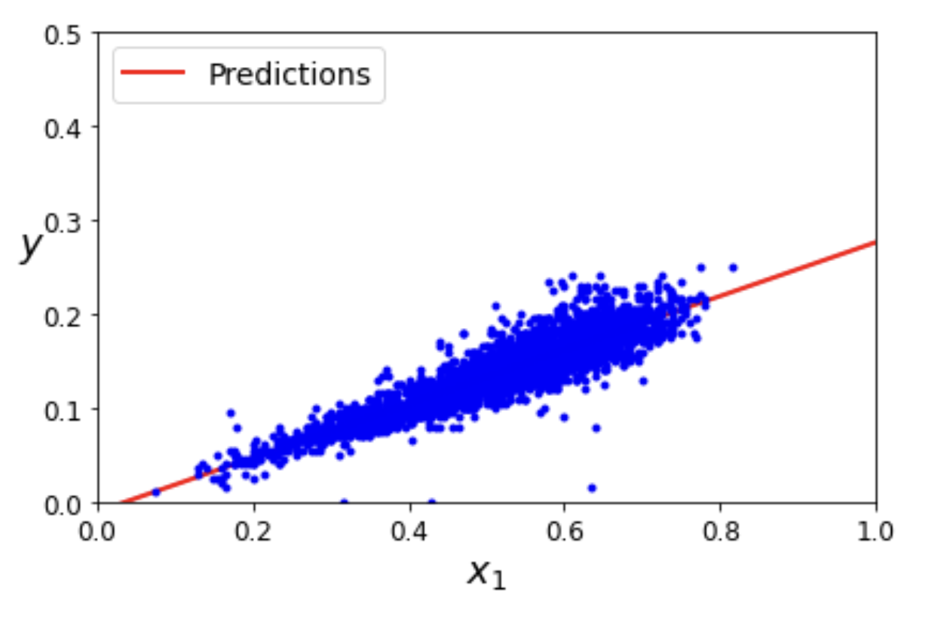
Results:
Theta: θ = array ( [ [-0.0108267], [0.28716253] ] )
Predicted Values = array ( [ [-0.0108267], [0.56349837] ] )

Slide 7
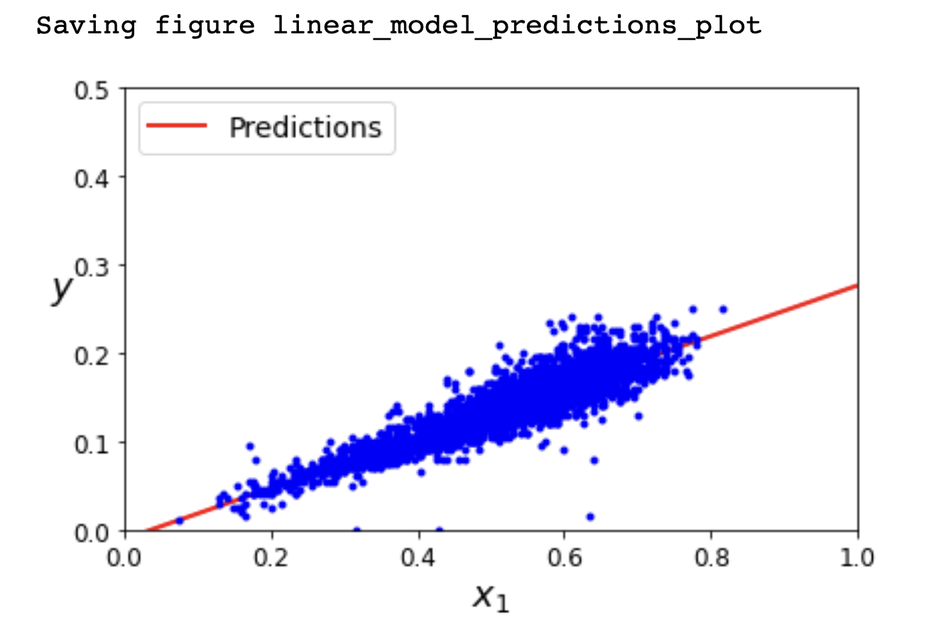
Testing:
I tested the same dataset by using “ Linear Regression Class” from sklearn.Linear Model and using “Singular-Value Decomposition” and the results were exactly the same.
Intercept, co-efficient= array ( [ [-0.0108267], [0.28716253] ] )
Predicted Values = array ( [ [-0.0108267], [0.56349837] ] )

Slide 8
Scikit-learn library:
Singular-Value Decomposition (SVD):
Basically I trained a linear regression model by using fit method, where I simply passed a feature matrix and target vector which in returns finds the best-fit parameters (i.e., the intercept and coefficients) that minimize the mean squared error between the predicted target values and the true target values.
The next step is to use the predict method in order to make predictions based on the trained model. This method uses the best-fit parameters which I have obtained from the training data earlier and got an array of predicted target values.
Calculated the best-fit parameters using the Singular Value Decomposition (SVD)

Slide 9
Enhancement Ideas
In future we can Improve the program by considering following factors:
Features: We can add more features to make a better prediction because height can depend on multiple factors so features selection can greatly impact the model's performance.
Model Accuracy: We can give more and more data for more accurate results
Model Evaluation: We can evaluate the model performance using different metrics, such as comparing the model's performance on the training and testing data which can also give you insights into overfitting or underfitting.
Overfitting: If the model has high variance and is overfitting the training data, we can reduce its complexity by using Lasso or Ridge regularization techniques.

Slide 10
Conclusion:
As we choose Normal Equation for this problem and later tested it with Linear Regression Class from sklearn.Linear Model and SVD and results were exactly the same.
Normal equation work well for small datasets, it directly computes the optimal values of the parameters that minimize the cost function. . In our program, as the data size was small so using the normal equation was a reasonable choice.
However, for larger datasets, the computational cost of using the normal equation becomes too high and it is better to use numerical optimization methods such as gradient descent.

Slide 11
Bibliography/References
What's the Role of Bias and Weights in Neural Network
How to Run Linear Regressions In Python Scikit-Learn
Understanding Linear Regression using Singular Value Decomposition

